Slide 1
SMART VOTING SYSTEM

Slide 2
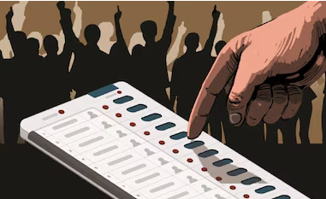
ROADMAP
Introduction
Materials and budget overview
Working Principle
System construction
Circuit Design
Project Display
Application
Reference material

Slide 3

INTRODUCTION
A voting machine is an electronic device designed to facilitate the casting and counting of votes in a secure, efficient, and tamper-resistant manner. It serves as a modern alternative to traditional paper ballots, ensuring accuracy, reducing human error, and enhancing the speed of the electoral process. Voting machines are widely used in various institutional and governmental elections to promote transparency and trust in democratic systems.

Slide 4
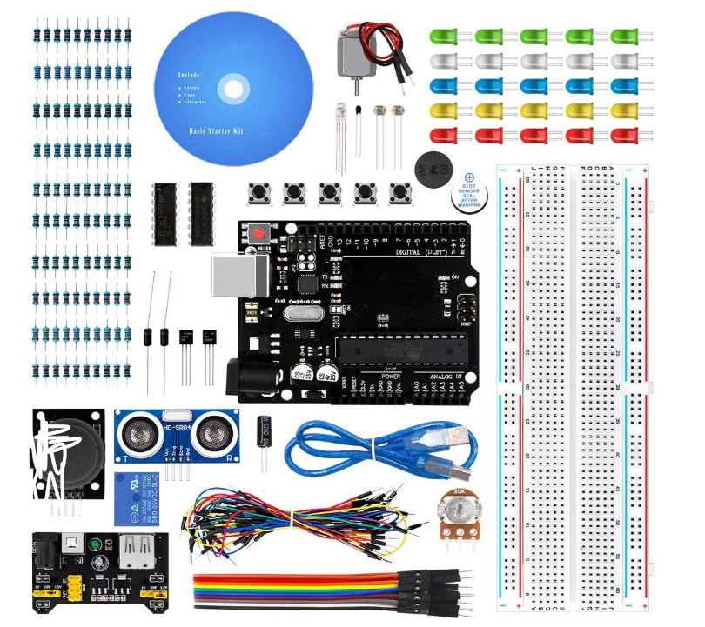
Materials AND BUDGET OVERVIEW
Arduino Uno Board – Cost: Rs. 349
Push Buttons (5 total) – Cost: Rs. 99
LEDs (for candidate indicators + error indication) – Cost: Rs. 15
Resistors (for LED and button safety) – Cost: Rs. 10
AND Gate IC (e.g., 7408) – Cost: Rs. 170
Breadboard – Cost: Rs. 145
Jumper Wires – Cost: Rs. 100
Power Supply
Buzzer – Cost: Rs. 13
4*4 Matrix keypad – Cost: Rs. 172
Total - Rs. 1073

Slide 5

WORKING PRINCIPLE
Password-Based Access Control: Voters receive a unique time-scheduled password via SMS, to be entered via keypad.
Verification Mechanism: Arduino validates the password against a preloaded list and marks used passwords.
Voting Enablement: Successful authentication enables one-time voting by activating candidate buttons.
Vote Casting Logic: A vote is registered with a single button press. Multiple presses are rejected.
Real-Time Vote Count: The system tracks votes in real-time for each candidate.
Result Declaration: Pressing the result button compares votes and lights up the LED of the winning candidate.

Slide 6
SYSTEM CONSTRUCTION
Keypad Authentication A 4×4 matrix keypad is used to enter unique, scheduled passwords for voting access.
Voting Buttons Four push buttons represent four candidates, each linked to an individual vote counter.
LED Result Indicators LEDs display voting results, lighting up for the winning candidate.
AND Gate Logic A 7408 IC ensures only one button press is valid; an error LED signals multiple inputs.
Buzzer Feedback A buzzer gives audio confirmation for valid access or invalid attempts.
Arduino Control Arduino Uno manages password validation, vote counting, and result display logic.

Slide 7
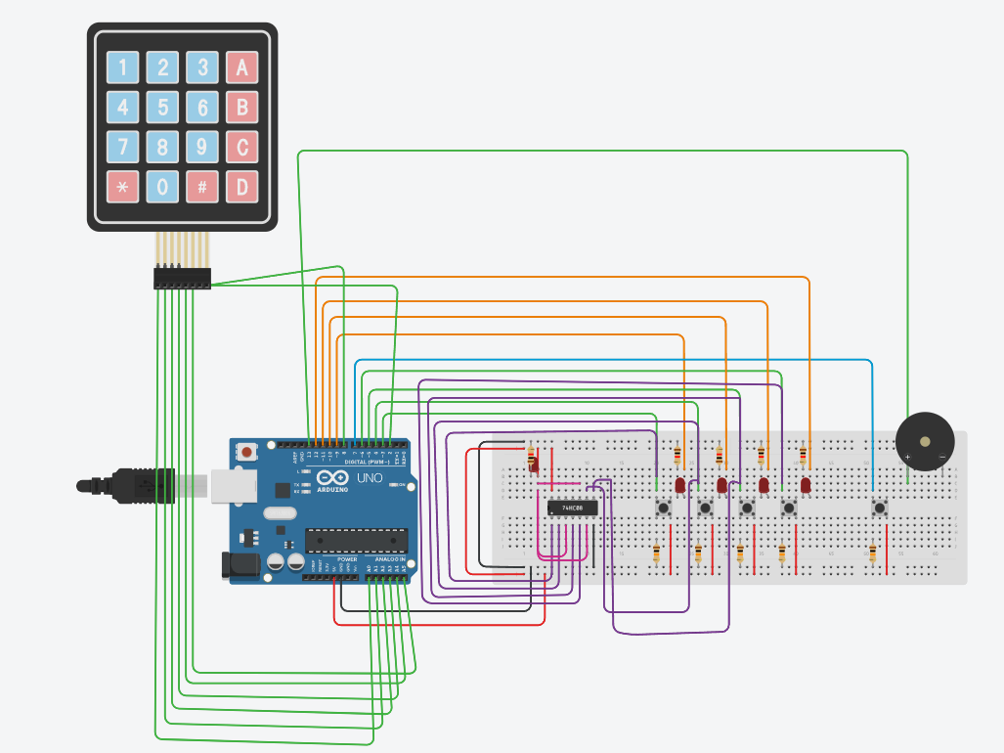
CIRCUIT DESIGN

Slide 8
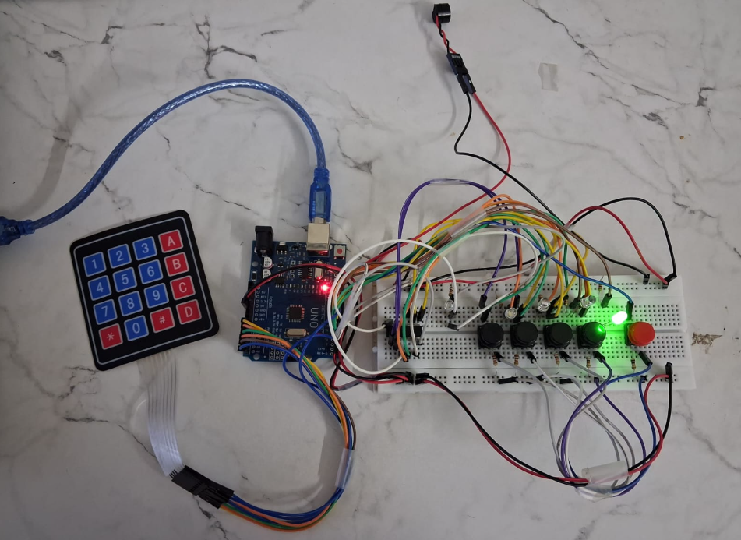
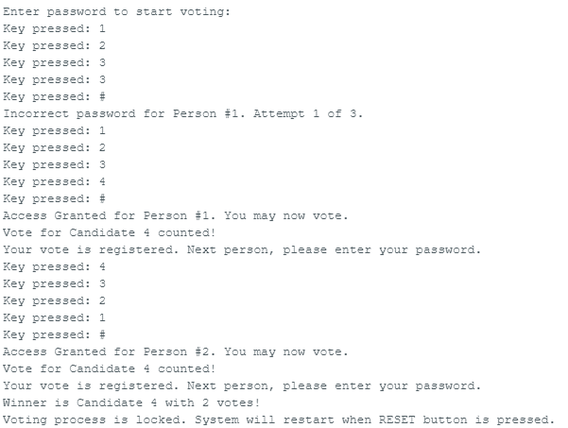
PROJECT DISPLAY

Slide 9
APPLICATIONS
Political elections
Student council elections
Shareholder voting
Television reality shows
Opinion polls and surveys
Corporate decision-making

